Slide 1
CSP571 Data Preparation and Analysis
Lecture 7. Data Vizualization
Oleksandr Narykov
onarykov@iit.edu

Slide 2
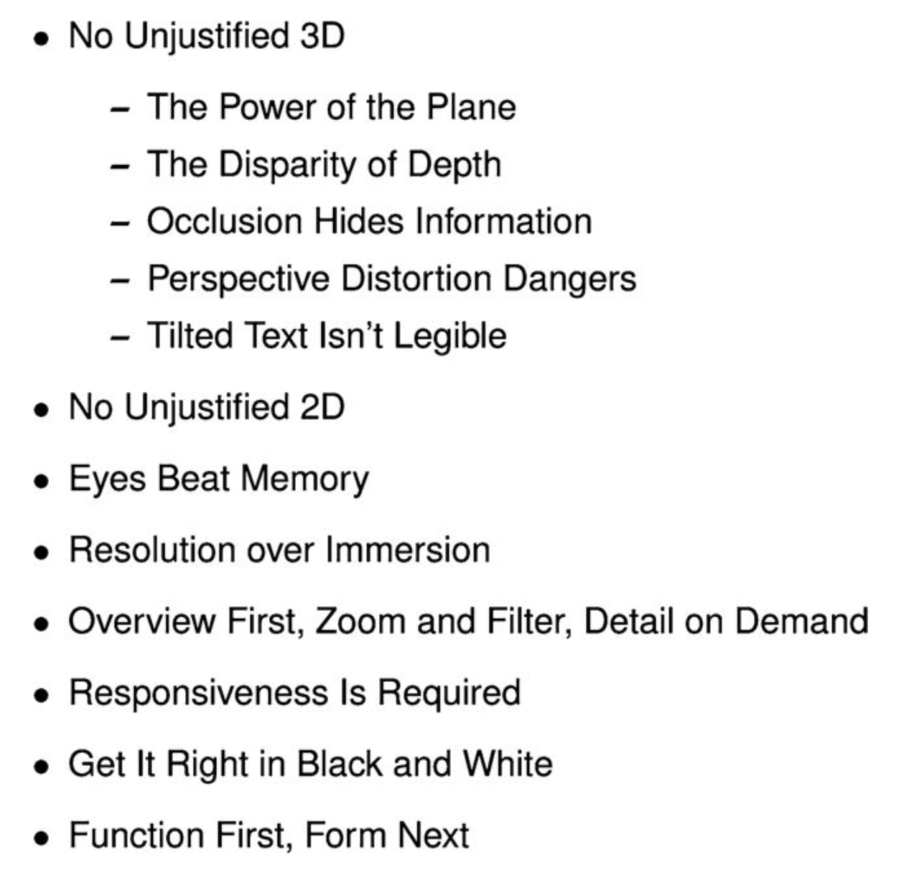
Rules of Thumb

Slide 3
Rules of Thumb

Slide 4
Eyes Beat Memory
https://youtu.be/qanJKhV6Jvw?si=fWL-Hz7nmeWPleCS
Change Blindness

Slide 5
Resolution vs. Immersion
If you are faced with a trade-off between resolution and immersion, resolution usually is far more important.
Immersive environments emphasize simulating realistic interaction and perception as closely as possible
Immersion is most useful when a sense of presence is an important aspect of the intended task

Slide 6
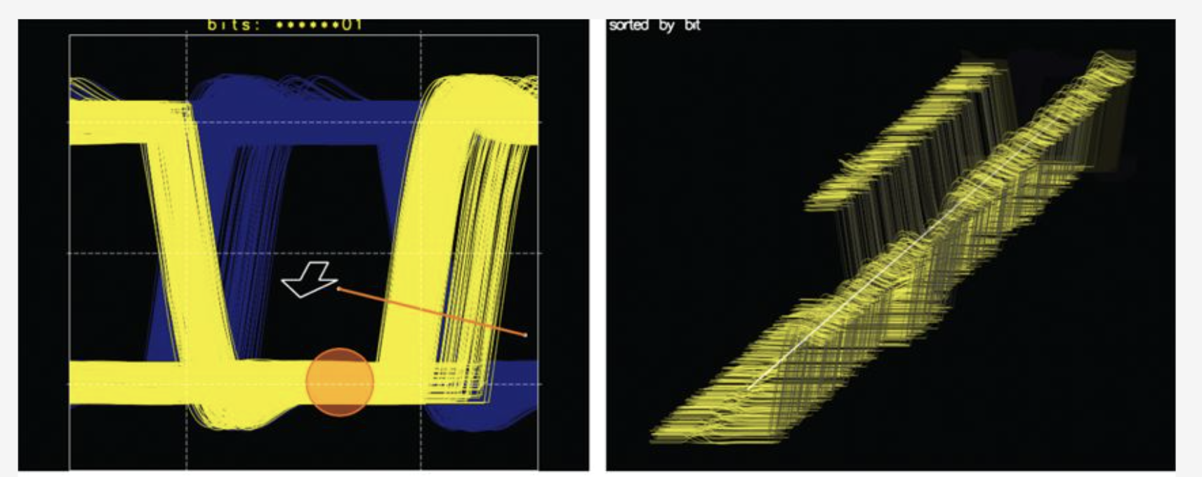
Overview First, Zoom and Filter, Details on Demand
Highlight the most important aspect of the data
Summarize and reduce

Slide 7
Visualizing Tabular Data

Slide 8
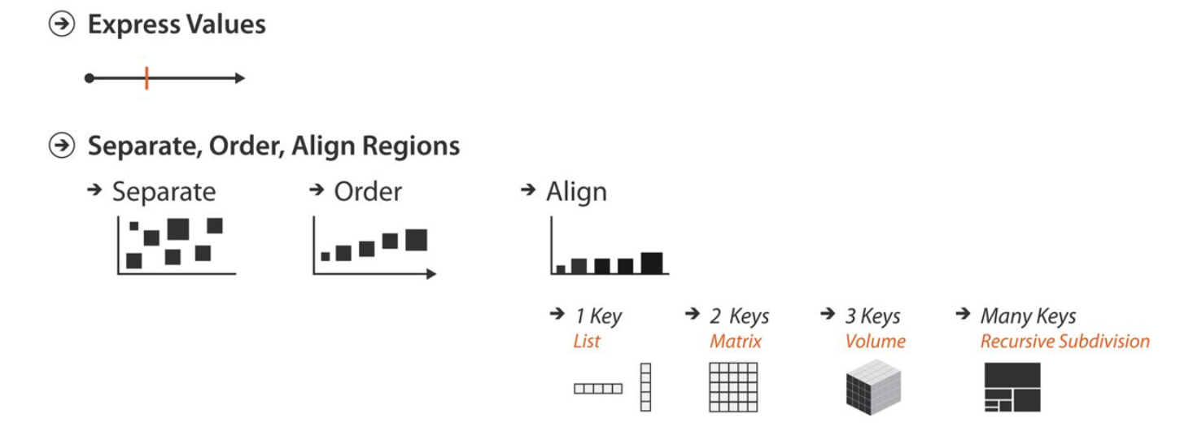
Key Points

Slide 9
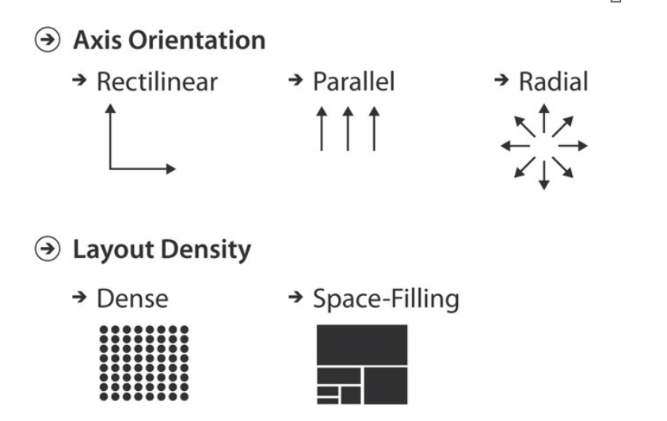
Key Points

Slide 10
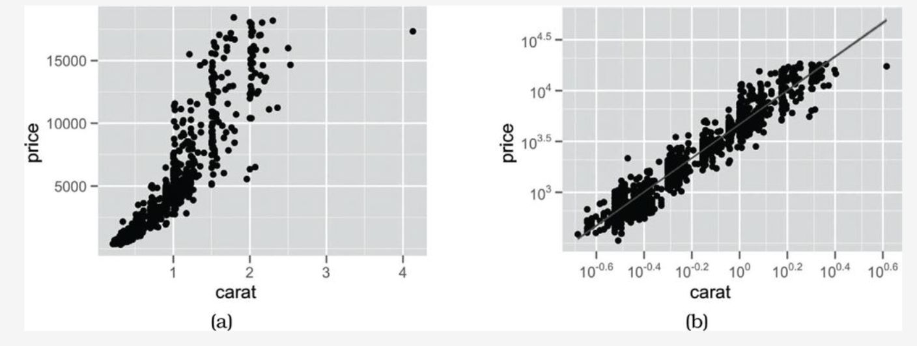
Express: Quantitative Values

Slide 11
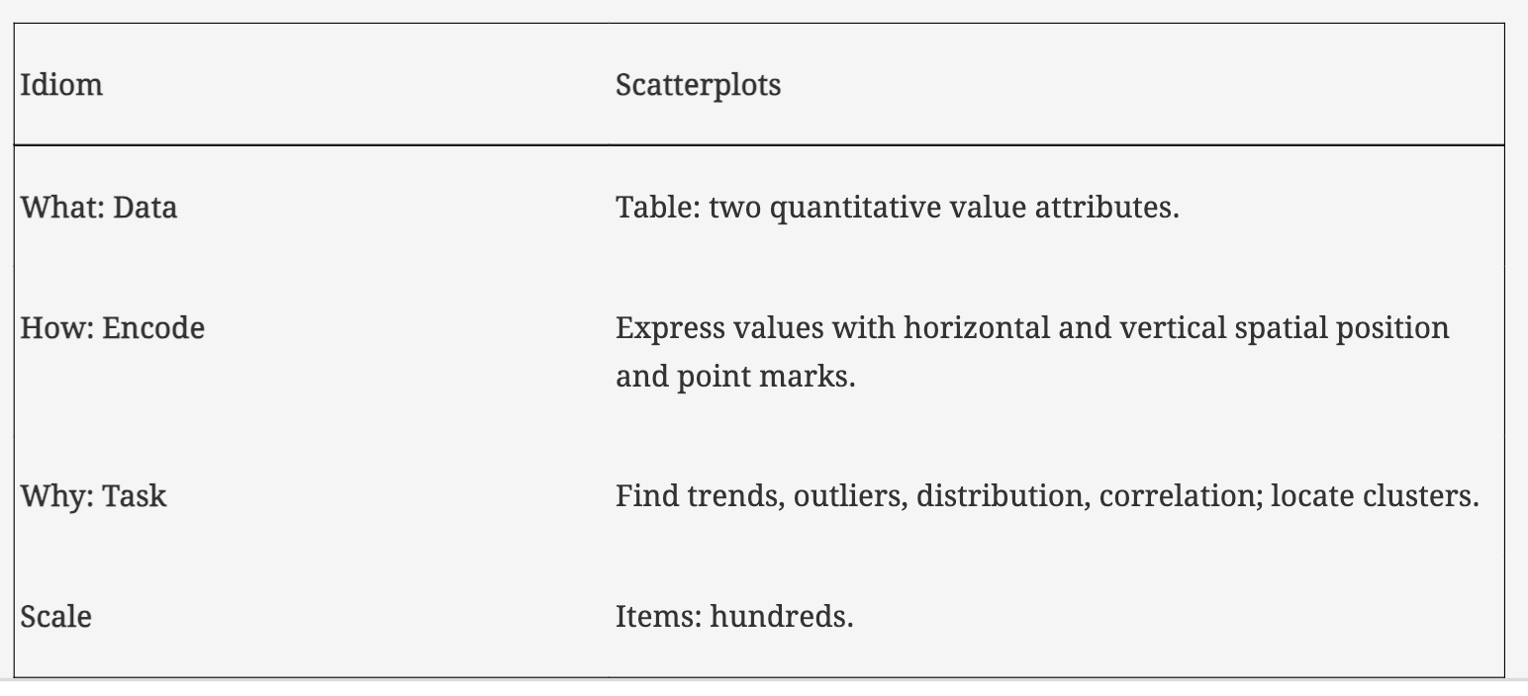
Express: Quantitative Values

Slide 12
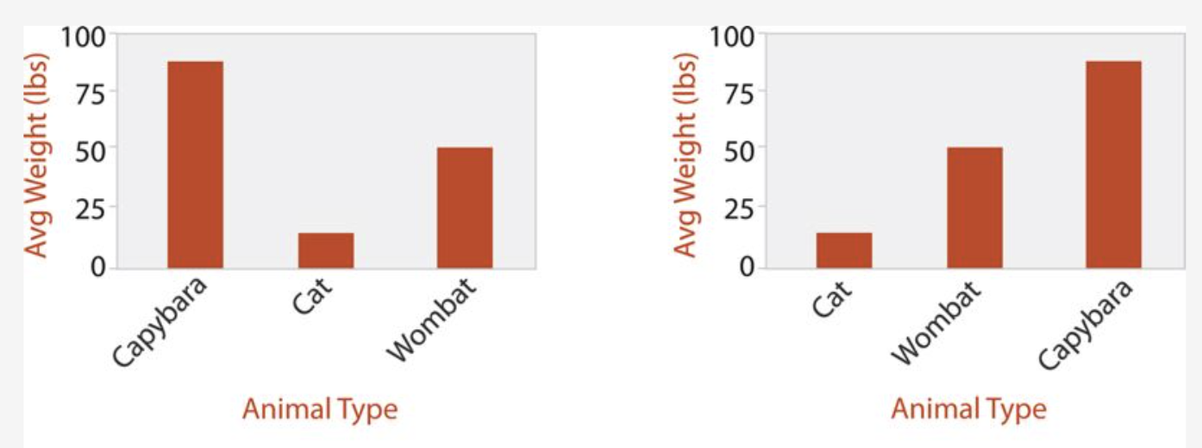
Bar Charts

Slide 13
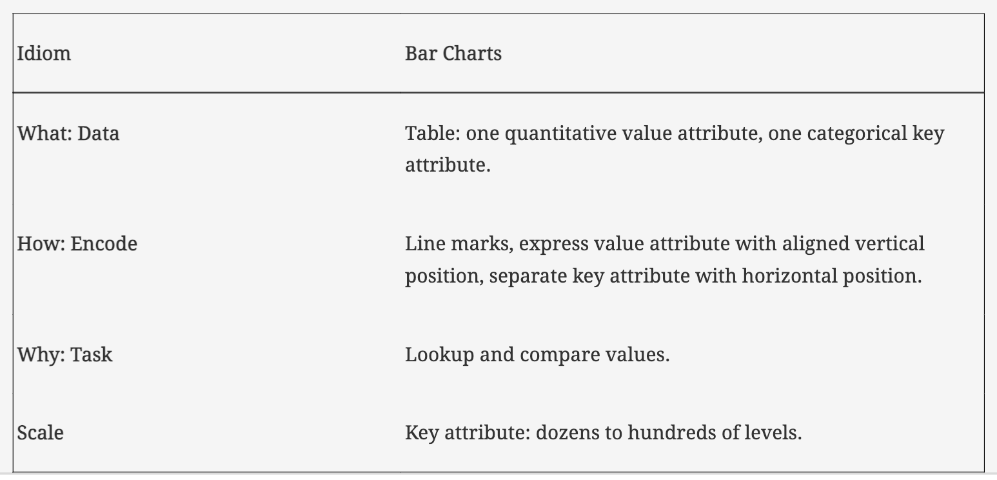
Bar Plots

Slide 14
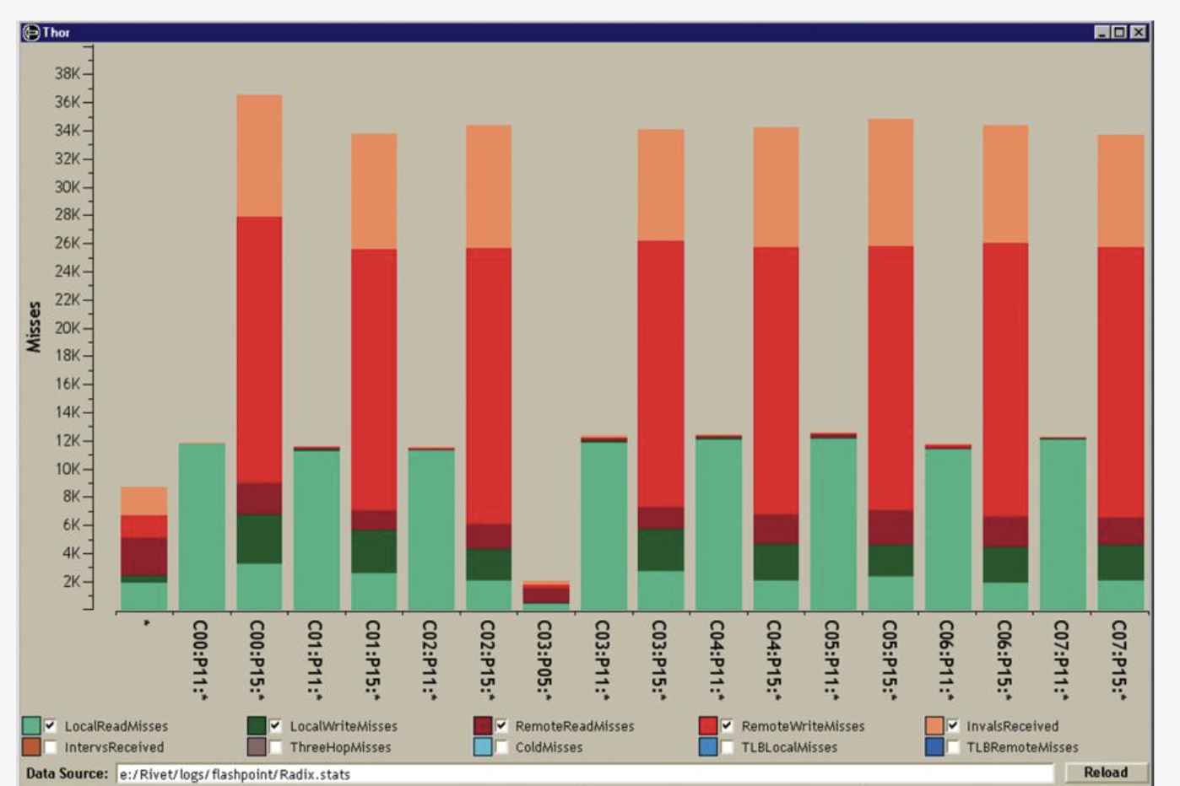
Stacked Bar Charts

Slide 15
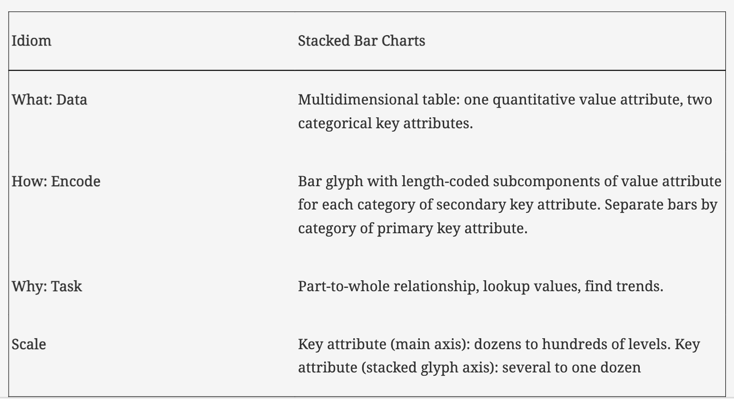
Stacked Bar Charts

Slide 16
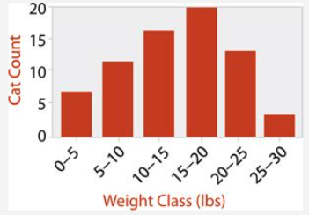
Histograms

Slide 17
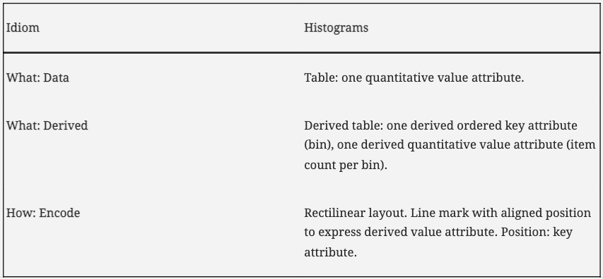
Histograms

Slide 18
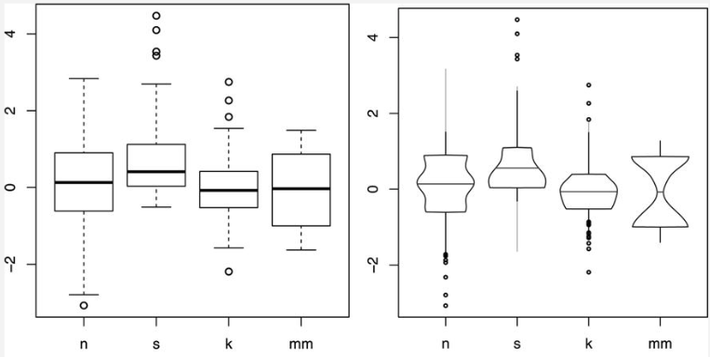
Boxplot Charts

Slide 19
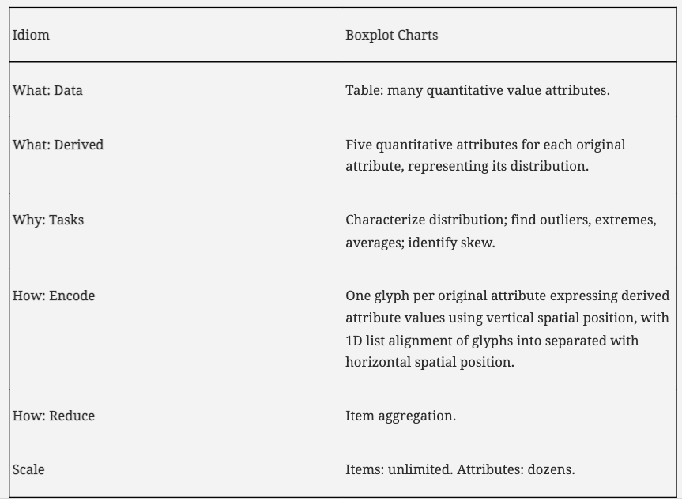
Boxplot Charts

Slide 20
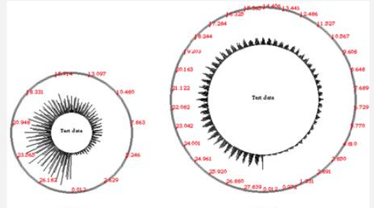
Solar Plots

Slide 21
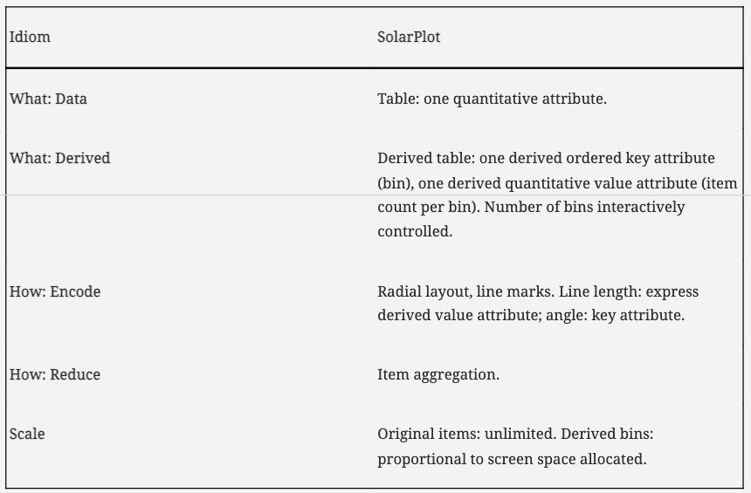
Solar Plots

Slide 22
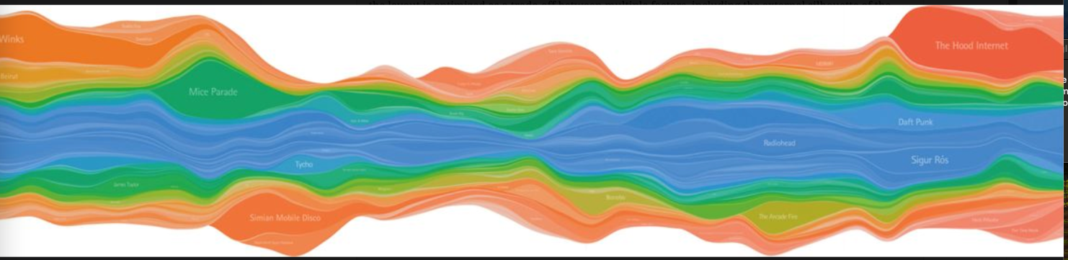
Streamgraphs

Slide 23
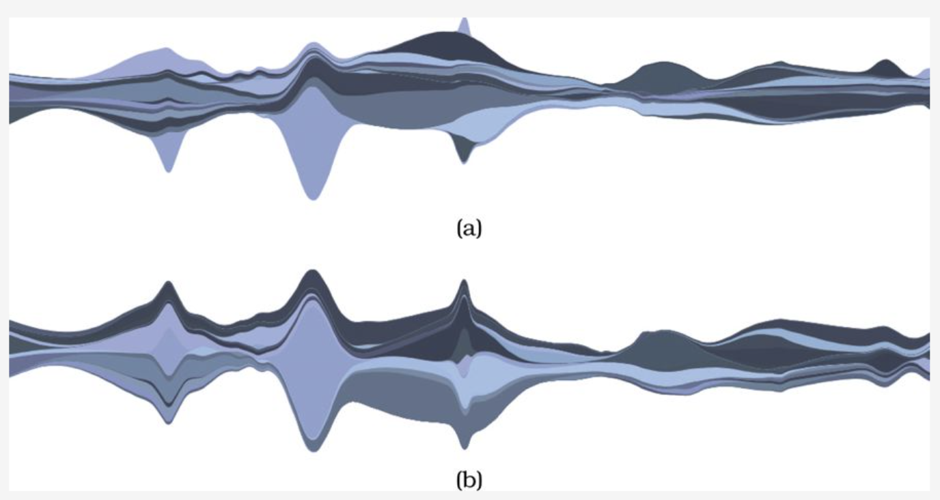
Streamgraphs

Slide 24
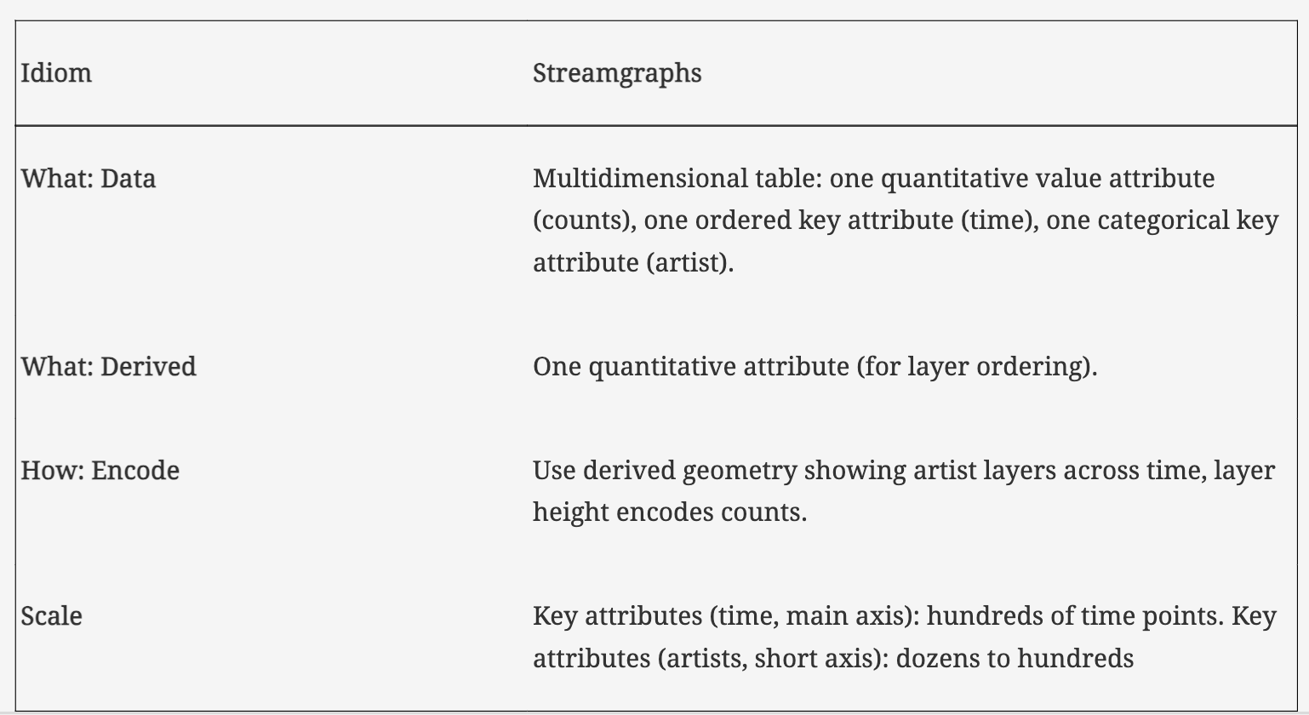
Streamgraphs

Slide 25
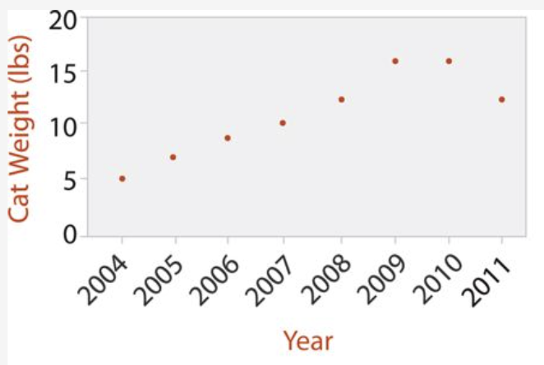
Dot Charts

Slide 26
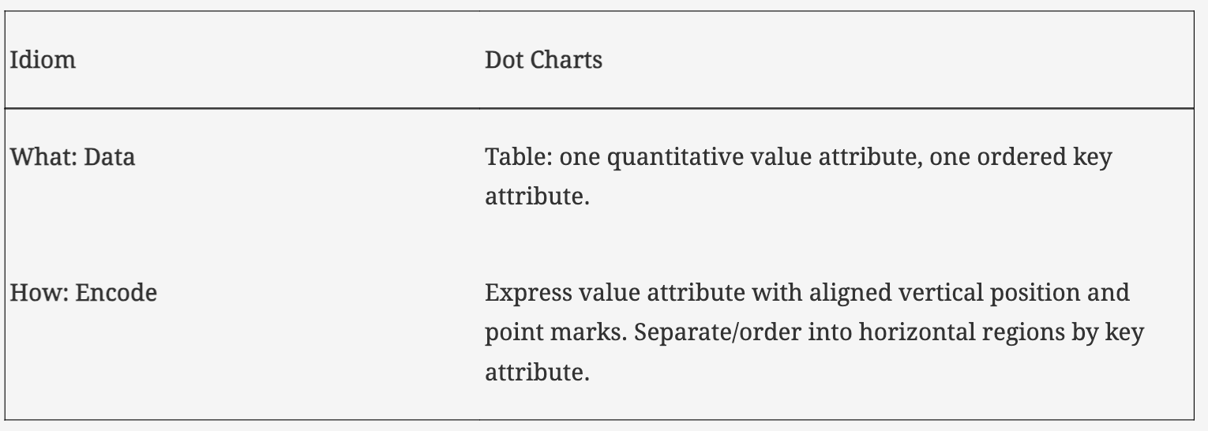
Dot Charts

Slide 27
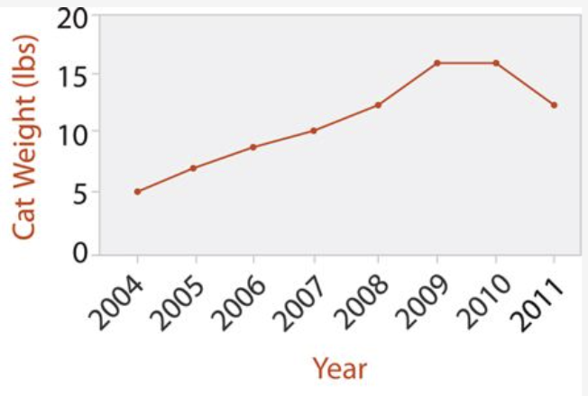
Line Charts

Slide 28
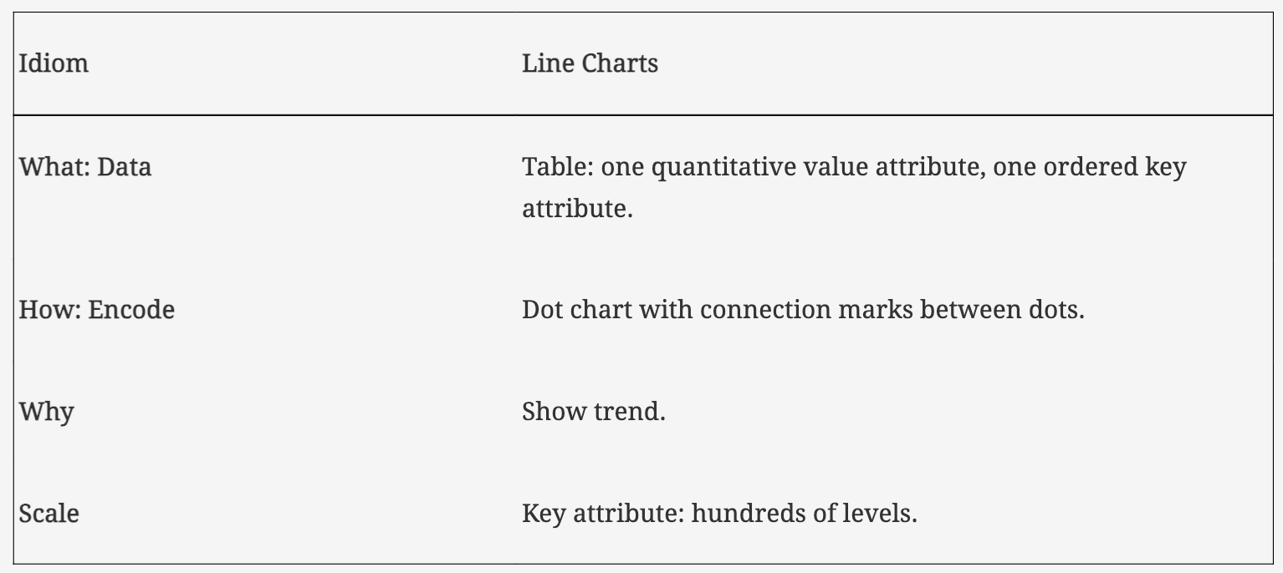
Line Charts

Slide 29
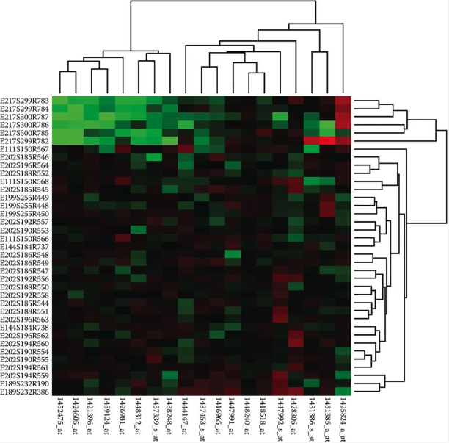
Cluster Heatmaps

Slide 30
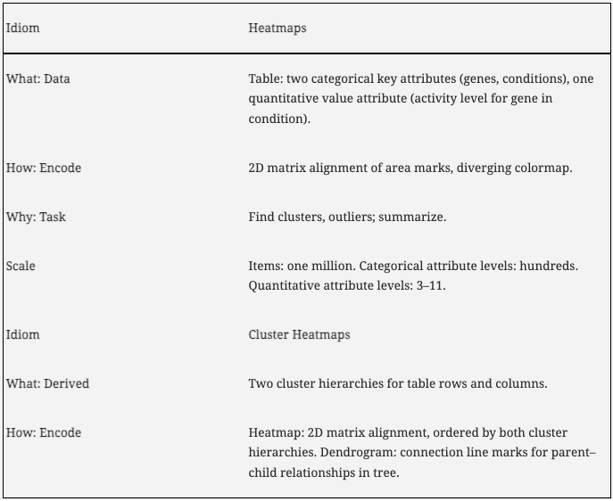
Cluster Heatmaps

Slide 31
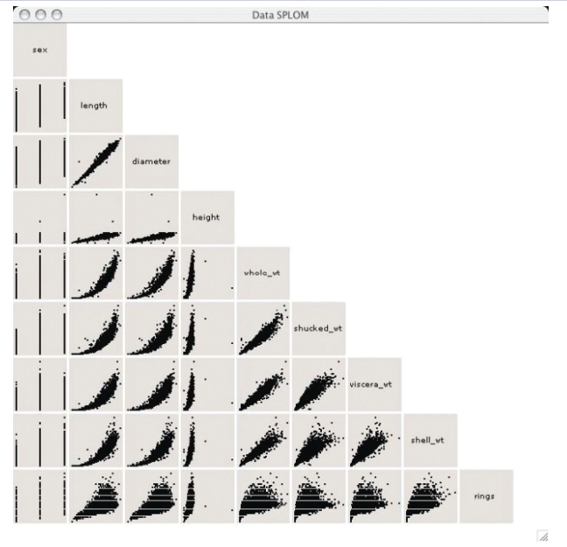
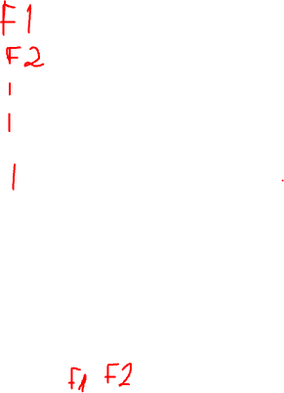
Scatterplot Matrix (SPLOM)

Slide 32
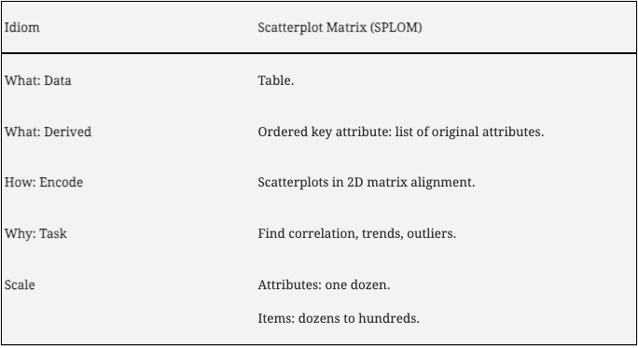
Scatterplot Matrix (SPLOM)

Slide 33
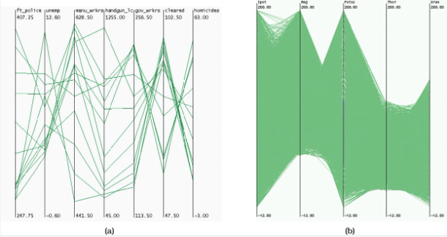
Parallel Coordinates

Slide 34
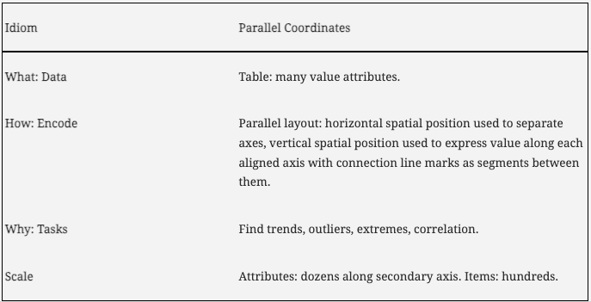
Parallel Coordinates

Slide 35
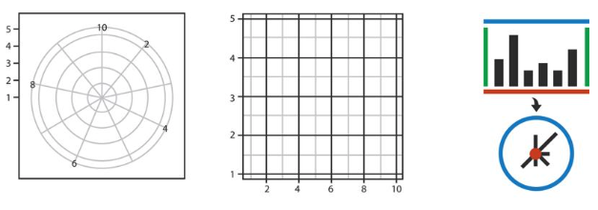
Radial Layout

Slide 36
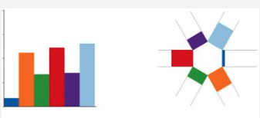
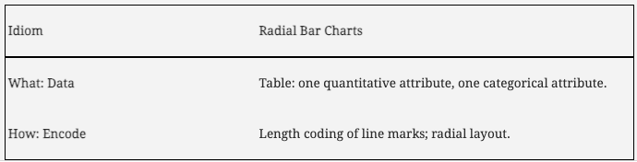
Radial Bar Charts

Slide 37
Radial Bar Charts

Slide 38
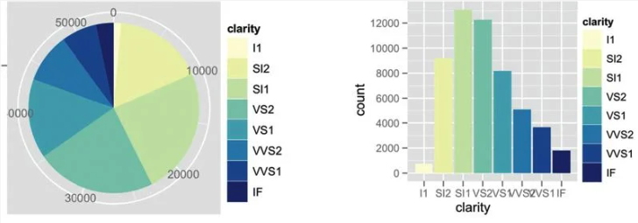
Pie Charts

Slide 39
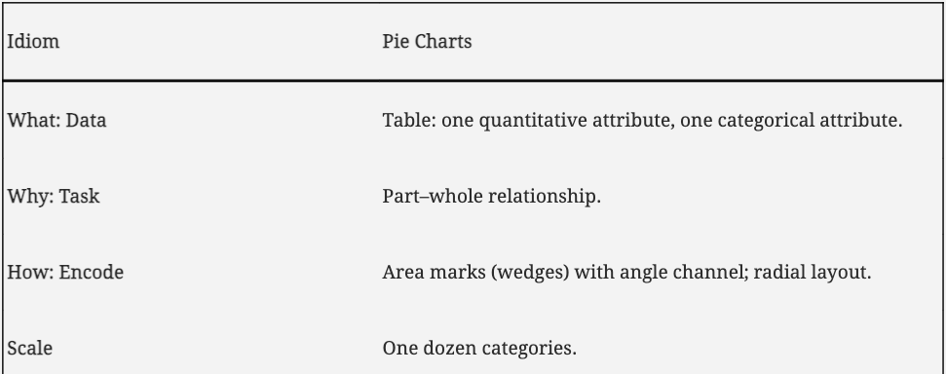
Pie Charts

Slide 40
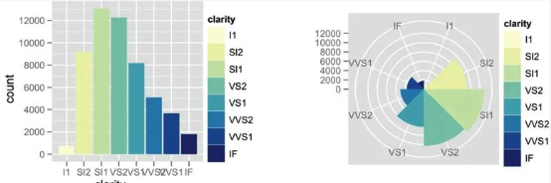
Polar Area Charts

Slide 41
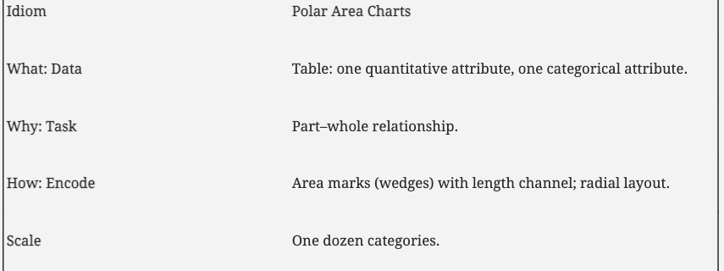
Polar Area Charts

Slide 42
Visualizing Spatial Data

Slide 43
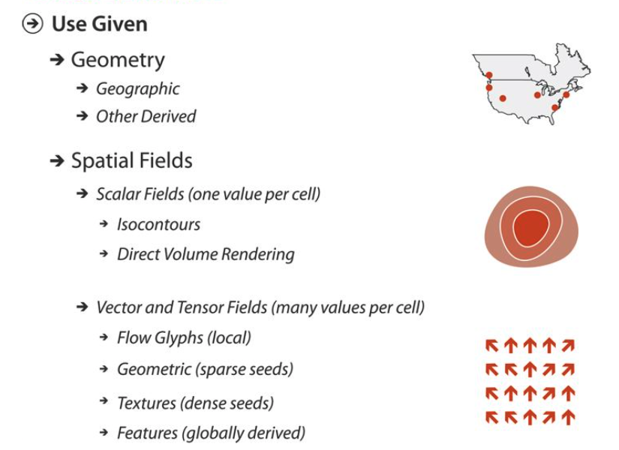
Spatial Visualization Key Points

Slide 44
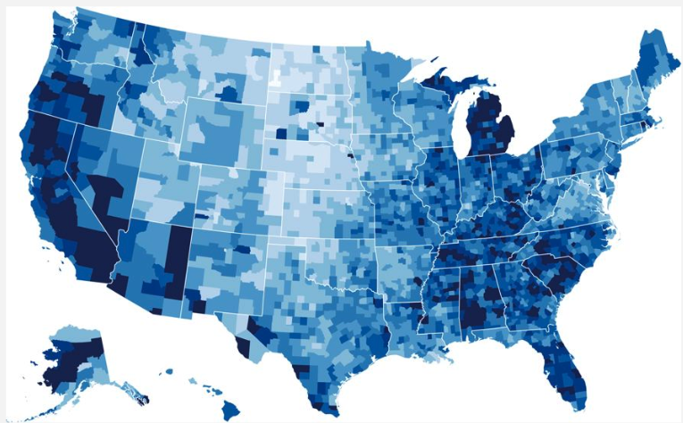
Choropleth Map

Slide 45
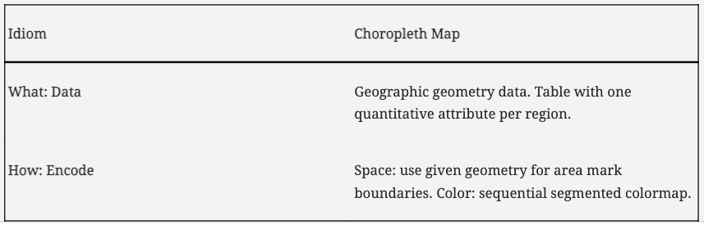
Choropleth Map

Slide 46
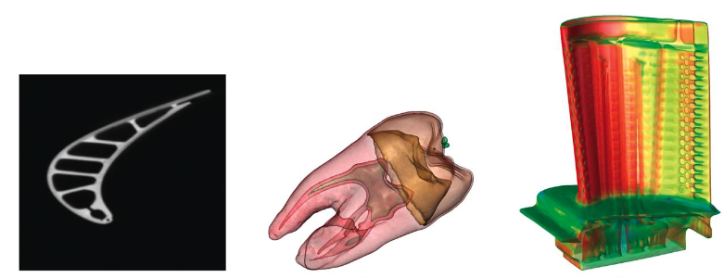
Scalar Field

Slide 47
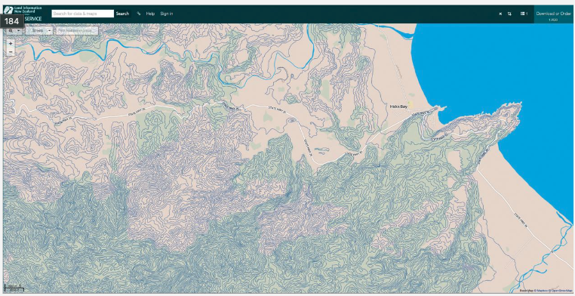
Topographic Terrain Map

Slide 48
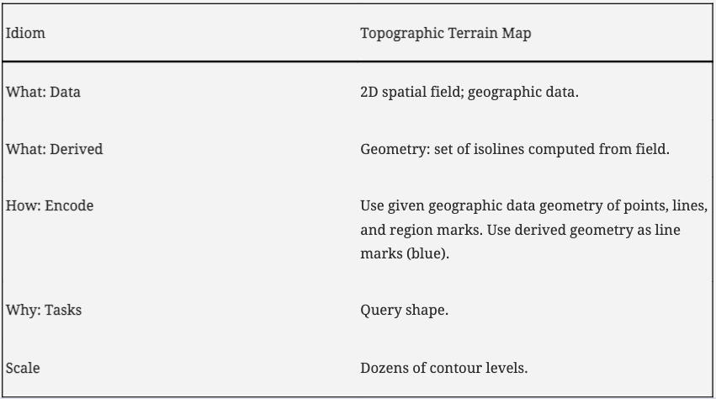
Topographic Terrain Map

Slide 49
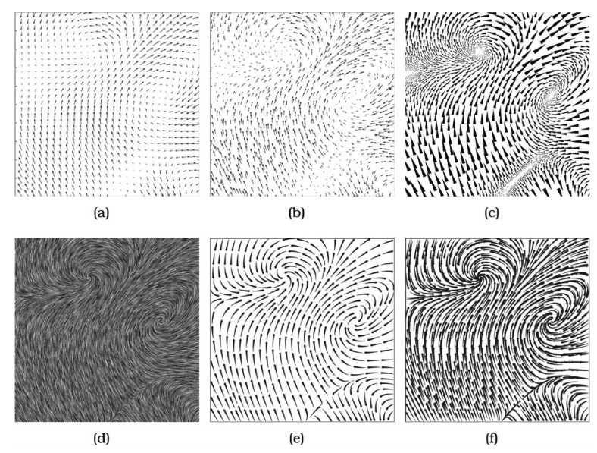
Vector Fields

Slide 50
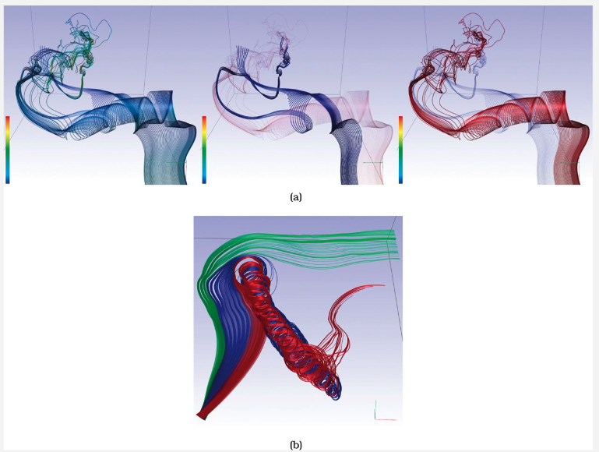
Similarity-Clustered Streamlines

Slide 51
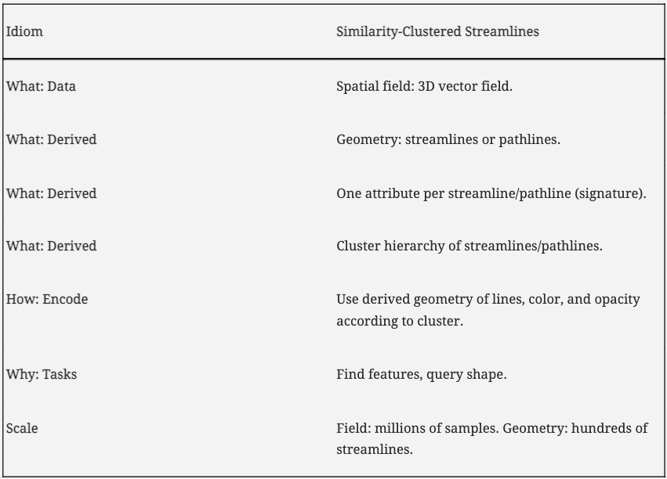
Similarity-Clustered Streamlines

Slide 52
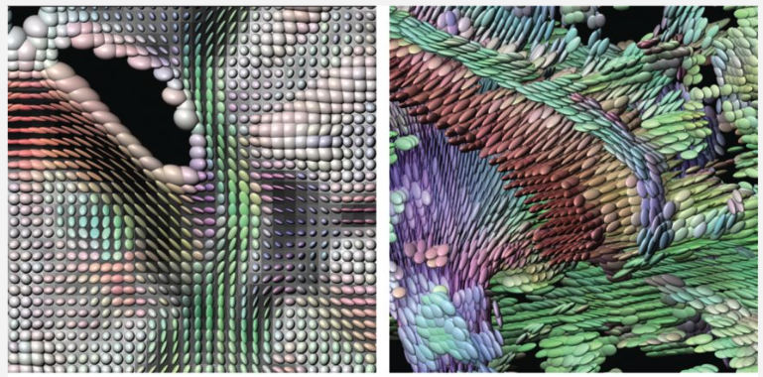
Tensor Fields. Ellipsoid Glyphs

Slide 53
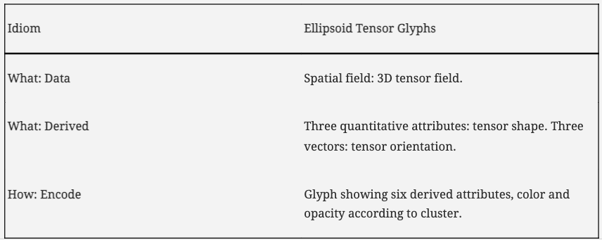
Tensor Fields. Ellipsoid Glyphs

Slide 54
Visualizing Networks and Trees

Slide 55
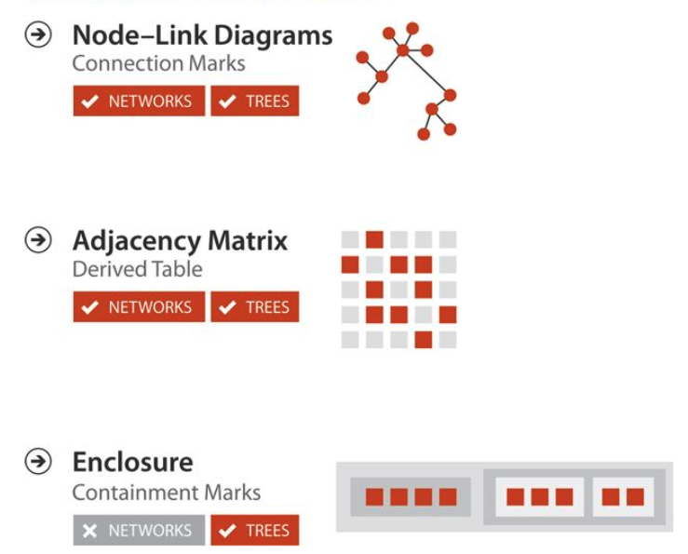
Key Points

Slide 56
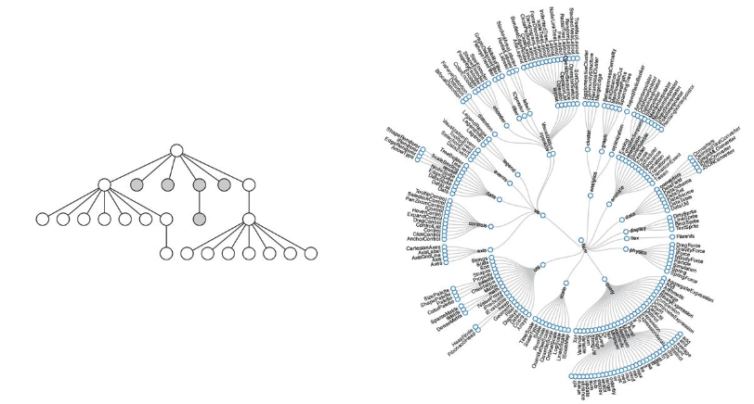
Node-Link Layout
Triangular Vertical
Spline Radial

Slide 57

Node-Link Layout
Rectangular Horizontal
BubbleTree

Slide 58

Node-Link Layout
Force-Directed Layout
Network with Size Coding for Node Attributes

Slide 59

Node-Link Layout

Slide 60

Multi-Level Force-Directed Placement (sfdp)

Slide 61

Multi-Level Force-Directed Placement (sfdp)

Slide 62


Matrix Views

Slide 63

Matrix Views

Slide 64

Matrix Views

Slide 65


Treemap

Slide 66

Treemap

